Slide 1

Smart Contract
&
Real -Estate

Slide 2
Problem Statement
Design a solution that will make transactions in the Indian digital ecosystem more convention and secure,ensuring real time fraud prevention.

Slide 3
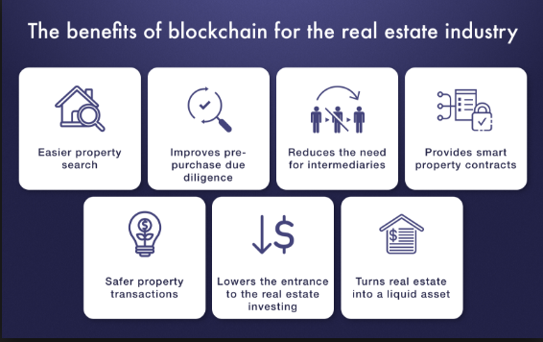
Our Current Issue
Lack of Trust
Tampering of the
Papers
Difficulty in Property Search & Transactions
Centralized Recordkeeping & Intermediates

Slide 4
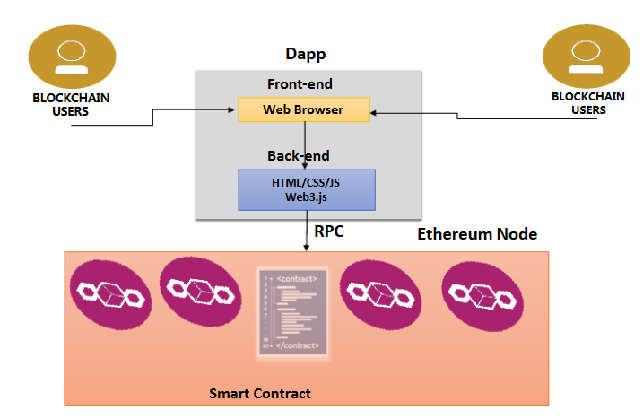
Our Product
We propose a design methodology for the smart contract which enables development of different use cases using Blockchain technology.
In this frame, the blockchain becomes the enabler for the development of paperless layer for all city transactions, in a secure fashion for the optimum management of the smart city’s assets.

Slide 5
DATA FLOW DIAGRAM
CONTRACT
INPUT
OWNER ADDRESS
OWNER ADD.
LOCATION
LOCATION
ADD LAND
COST
COST
LAND ID
OWNER ADDRESS
UPDATE
BLOCKCHAIN
NETWORK
OUTPUT
LAND ID
LOCATION
COST

Slide 6
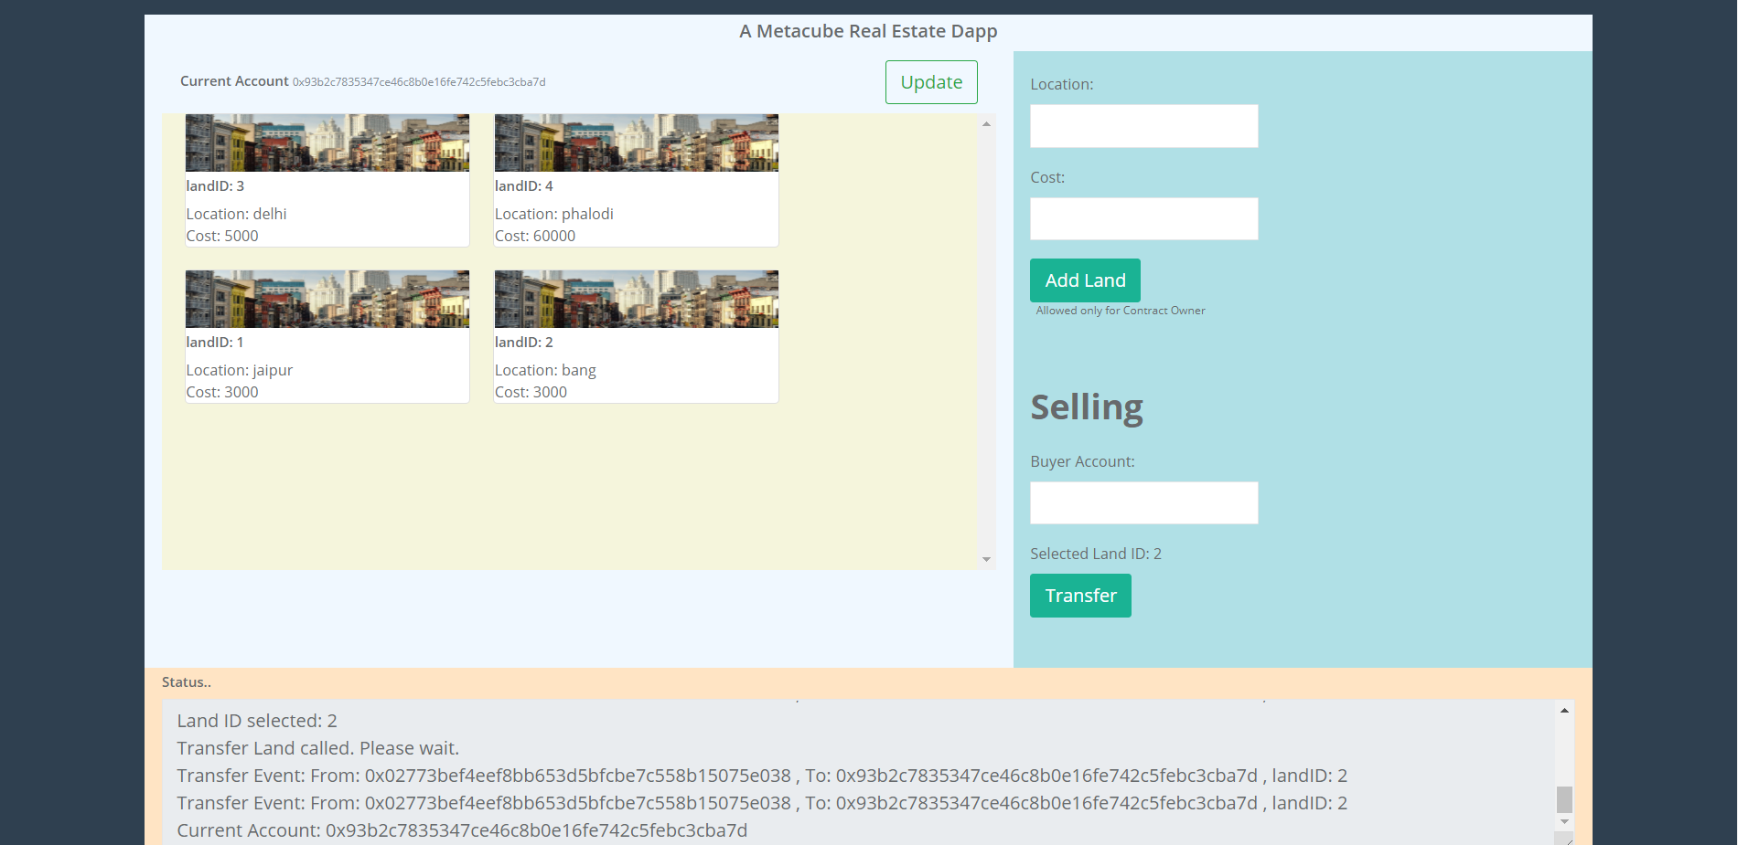

Slide 7
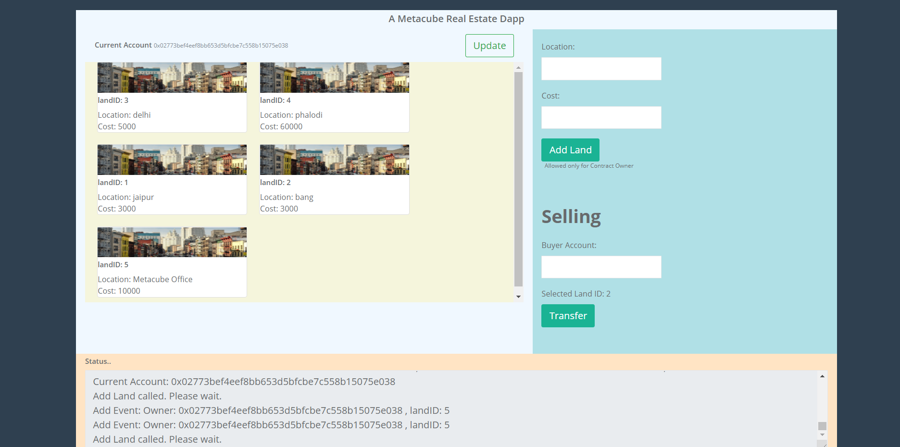

Slide 8
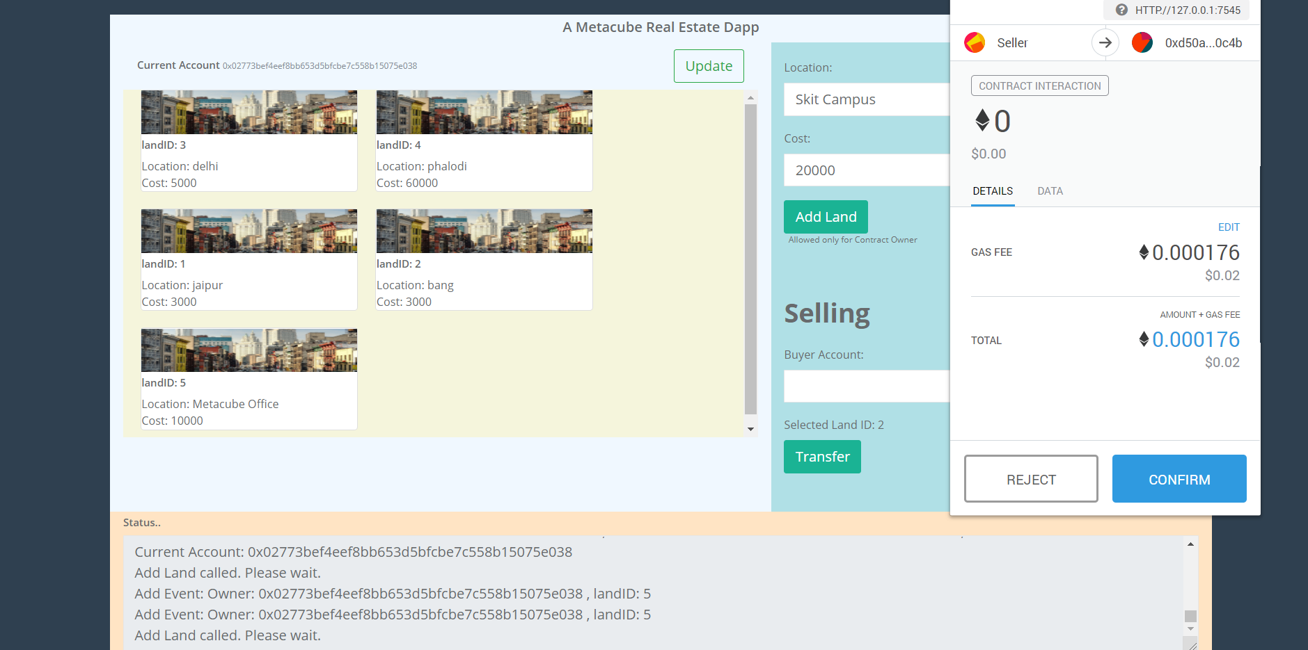

Slide 9
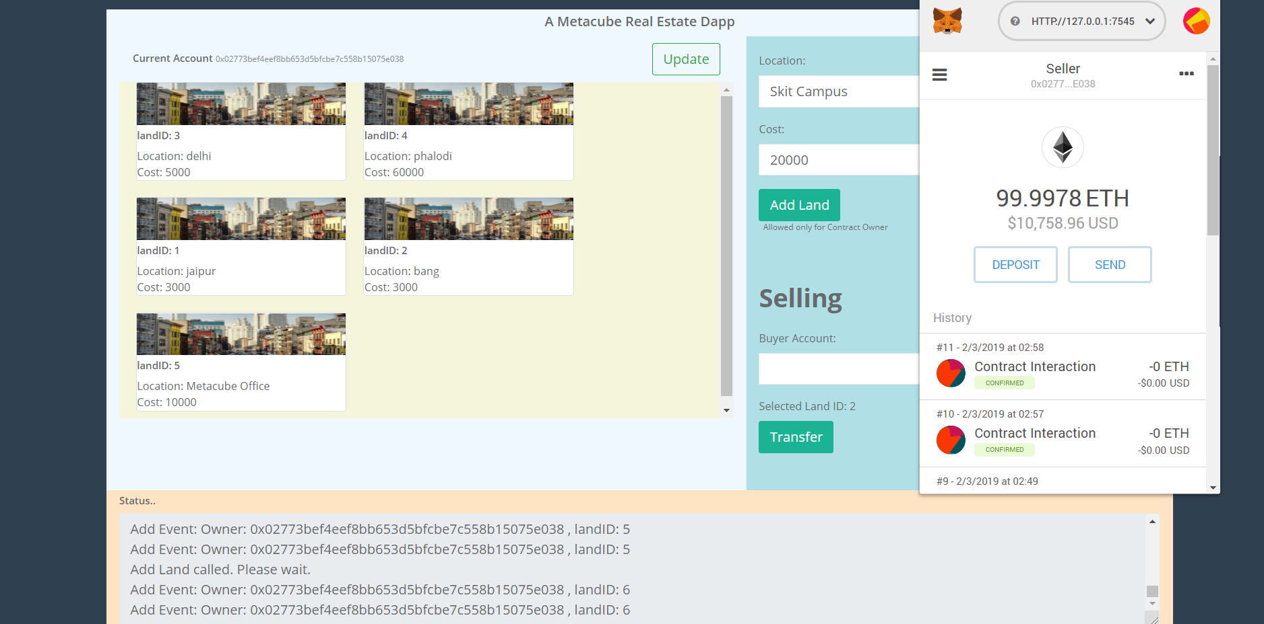

Slide 10
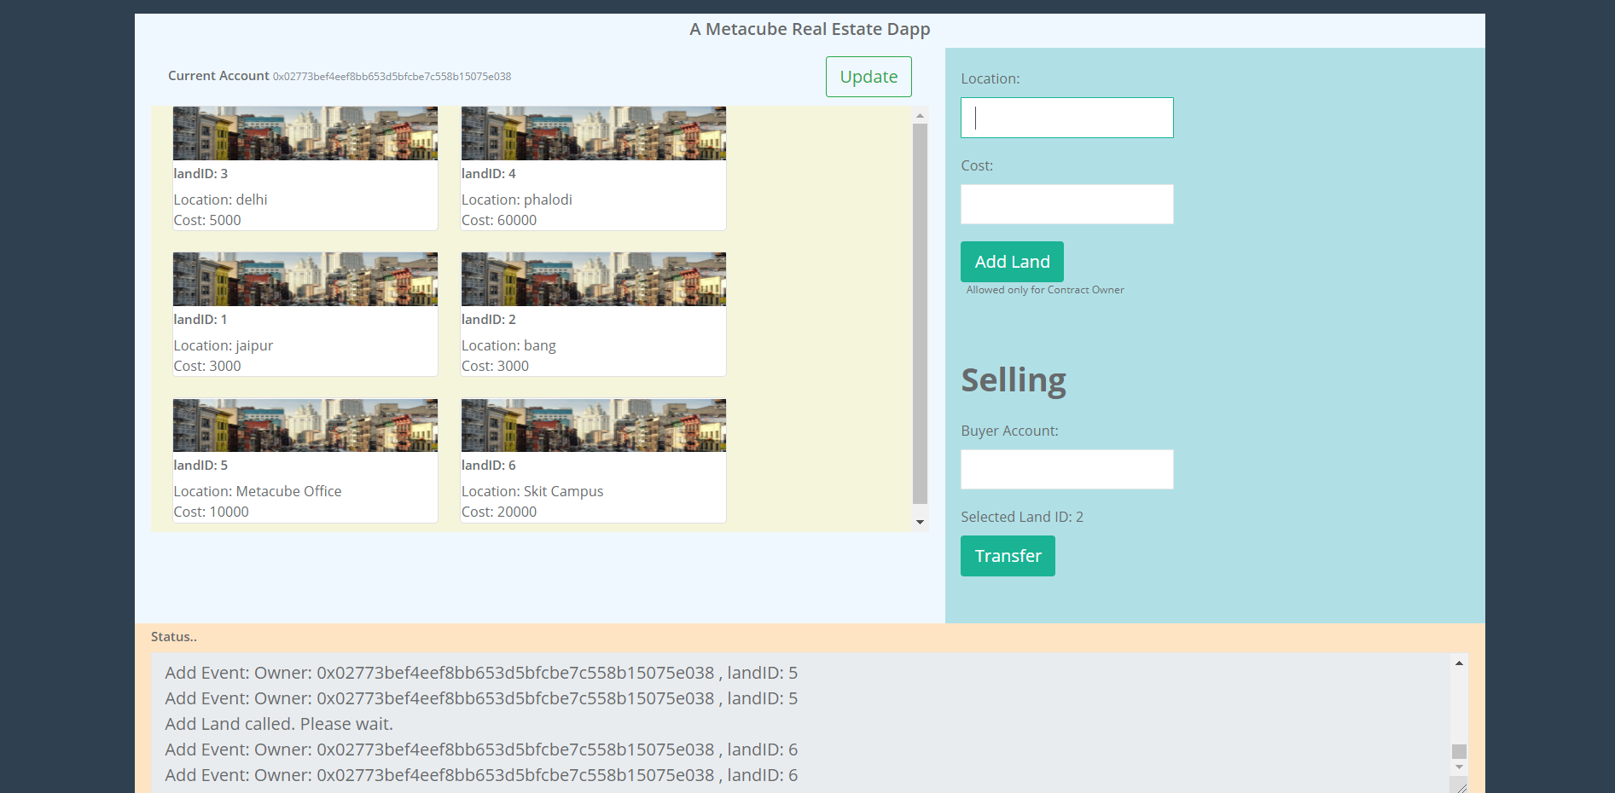

Slide 11
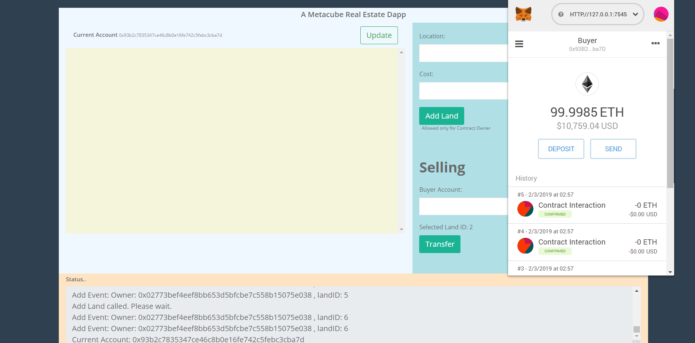

Slide 12
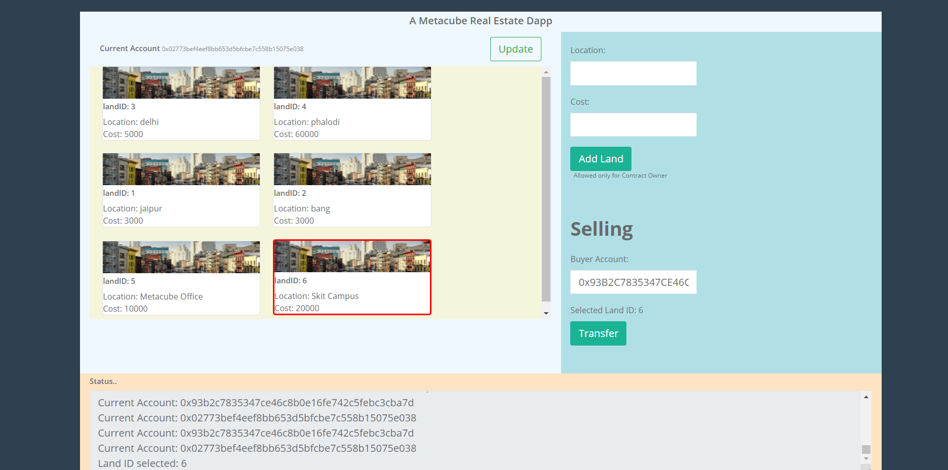

Slide 13
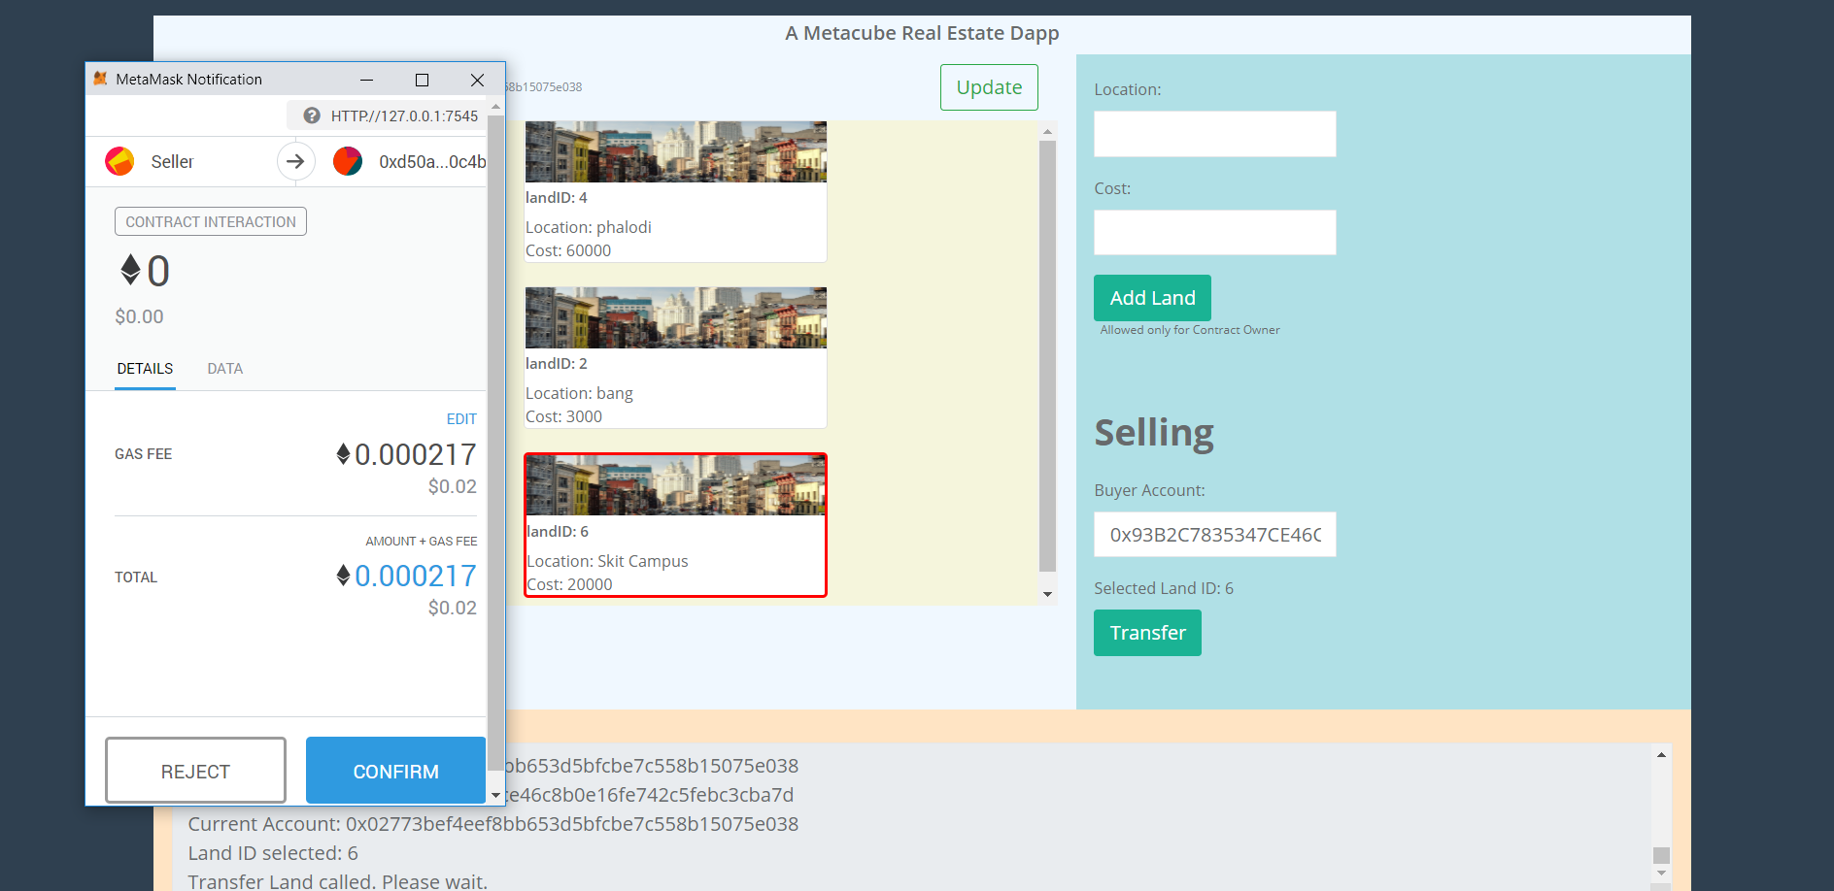

Slide 14
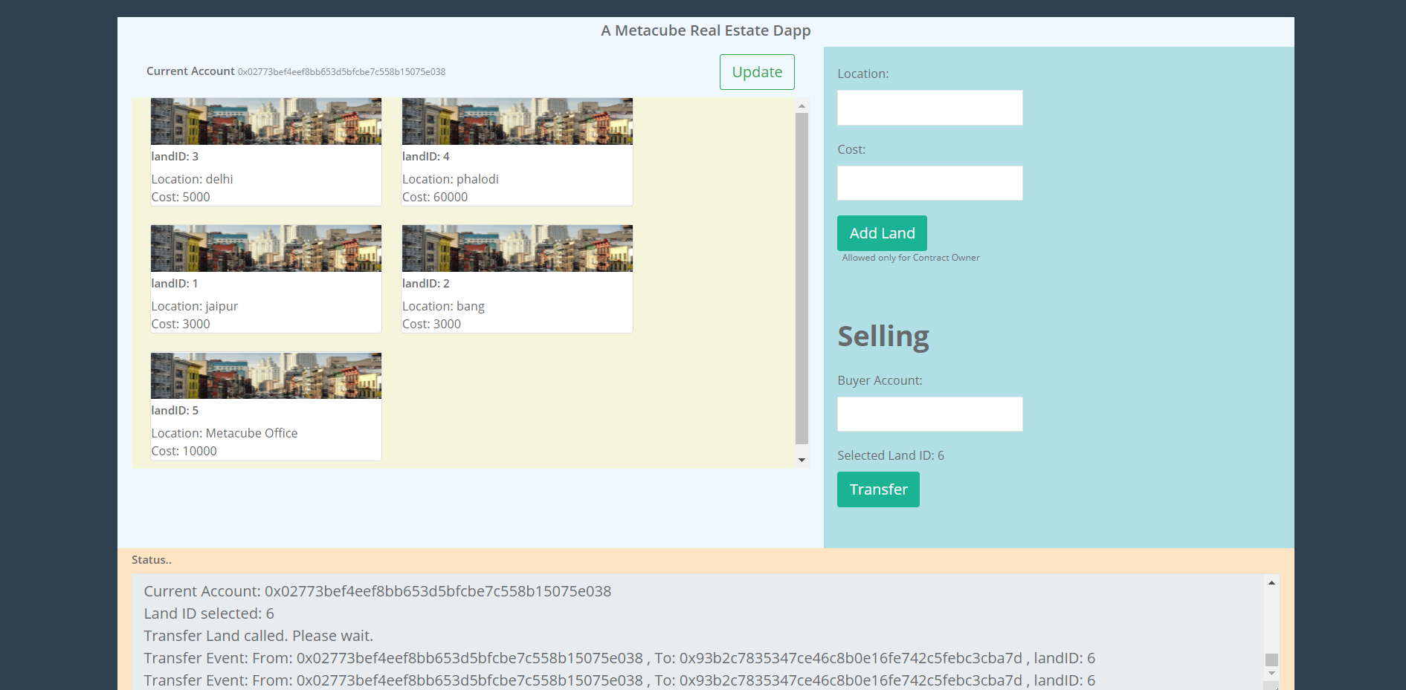

Slide 15
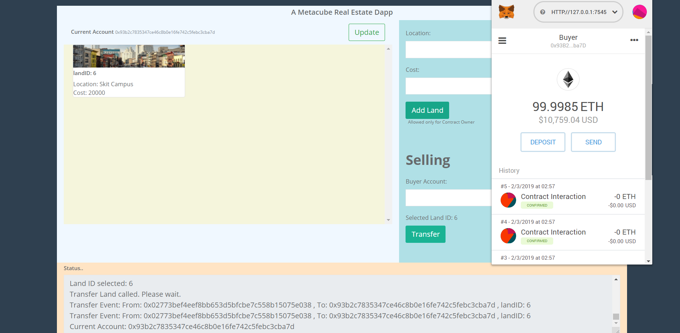

Slide 16
1. Join developres and entrepreneur groups on social media. 2. Generate links so that it is easily accessible by the user. 3. Available in all languages. 4. Rollout new updates constantly. 5. Get feedback from user. 6. Sincerely respond to query and reviews.
Marketing strategy

Slide 17
BASIC PLAN
DEVELOPMENT COST-(RS.2.5-3LAKH APPROX.)
(ONE TIME PAYMENT)
WEBSITE DOMAIN PURCHASE
WEBSITE HOSTING
WEBSITE DEVELOPMENT-2+4
LOGO DESIGNING-1
CONTENT DESIGN-2
PERSONAL EMAILS
SEARCH ENGINE OPTIMIZATION-1
TECHNICAL SUPPORT-1

Slide 18
BASIC PLAN
PRODUCT RUNNING COST+PRODUCT MARKETING COST
(RS.1.5-2LAKH /PER MONTH approx)
DATA COLLECTION.(40,000+SHOPS)
(RECRUITMENT OF 10 MEMBERS)
PRODUCT MARKETING.(OFFLINE+ONLINE+OFFERS MANAGEMENT)
(RECRUITMENT OF 4 MEMBERS)
PRODUCT RUNNING(WATCH+OPERATIONS MANAGEMENT)
RECRUITMENT OF 4 MEMBERS

Slide 19
MONEY FLOW
INITIAL-RS 2.5-3LAKH APPROX(OTP)
3 MONTHS-RS 5 LAKH APROX
6 MONTHS-RS10 LAKH APPROX
12 MONTHS-RS20 LAKH APPROX
24 MONTHS-RS50 LAKH APPROX

Slide 20
REVENUE GENERATION Time after which revenue will start getting generated.
Worst case-12 month
Medium case-6months
Top case-3month

Slide 21
RETURN CALCULATED:
Worst return at end of 1 year-RS 5 lakh+2 LAKHAPPROX(10)
Medium return at end of 1 year-RS 20lakh+10 APPROX (40)
Top class return-RS.30 LAKH+20 LAKH APPROX(60)

Slide 22
THANK YOU FOR YOUR VALUABLE TIME
TEAM NAME-BLOCKGEEKS

